Slide 1
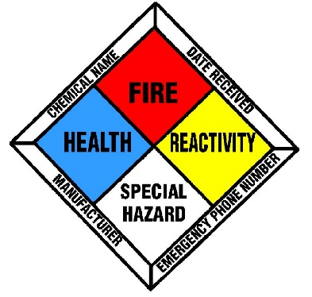
Chemical Safety
Rami E. Kremesti M.Sc.

Slide 2
The Need for Chemicals
Fuel
Cleaning
Personal Hygiene
pH control
Biocides/Disinfection
Packaging
Pharmaceuticals
Water Treatment
Corrosion Control
Machine Lubrication
Paints/Finishes
Concrete/Building Materials
Clothing/Textiles
Fire Fighting
Adhesives
Solvents
NDT (QC)
Food industry (flavorings, preservatives)
Chemical Analysis
Crowd Control
Agriculture

Slide 3
Types of Chemicals
Acids
Bases
Oxidizing Agents
Reducing Agents
Desiccants (Dehydrating agents)
Organic
Inorganic
Surfactants
Coagulants
Dyes
Adsorbents
Chelants
Inert
Radioactive
Explosive
Photosensitive
Buffers
Catalysts
Metals
Metalloids
Poisons

Slide 4
Types of Chemical Reactions
Red-ox Reaction (Ex. Fuel Combustion)
Neutralization
Dissolution
Precipitation
Chelation
Decomposition
Substitution
Photochemical

Slide 5
Main Properties of Chemicals/Chemical Reactions
Toxic
Carcinogenic/Mutagenic
Oxidizing
Corrosive
Explosive
Volatile
Hygroscopic
Coagulants
Exothermic/Endothermic
Radioactive
Lachrymator

Slide 6
MSDS
Material Safety Data Sheet describes the properties of the chemical, its health risks and potential environmental impact.
Appropriate Fire fighting/Accidental Release procedures/measures are also described.
First aid measures in case of exposure
Appropriate Storage Conditions/handling
Supplier contact info and Emergency Contact Number

Slide 7
Detecting/Characterizing Chemicals
pH
Conductivity
Spectrophotometry
NMR
IR Spectroscopy
Crystallography
Mass Spectrometry
Gas Chromatography
HPLC
MP/BP/LOI

Slide 8
Chemical Resistance/ Compatibility Charts
Every chemical has a chemical resistance chart that outlines which materials are suitable for storing/conveying this chemical
There are chemical compatibility charts also for chemical warehouse storage managers. MSDS is still best place to check.

Slide 9
Safety/Environmental Legislation
COSHH: Control of Substances Hazardous to Health
PPG: Pollution Prevention Guidelines
CLP: Chemical Labeling and Packaging
REACH: Registration, Evaluation, Authorisation and Restriction of Chemicals
Control of Major Accident Hazards (COMAH)

Slide 10
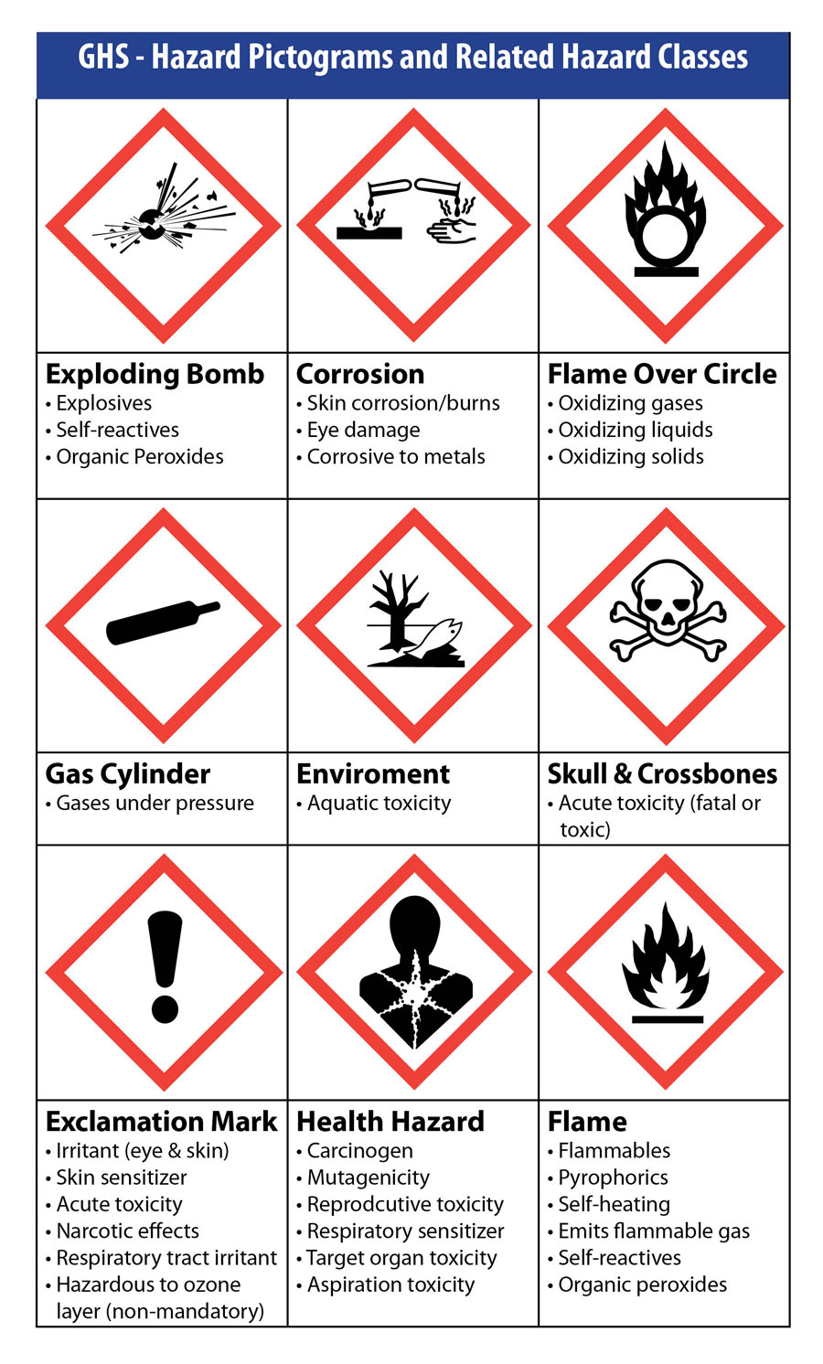
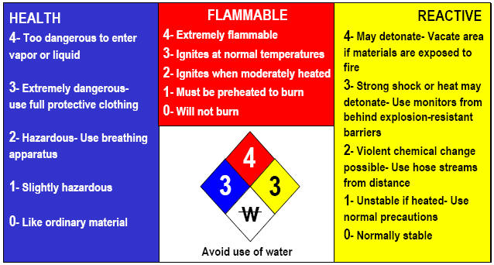
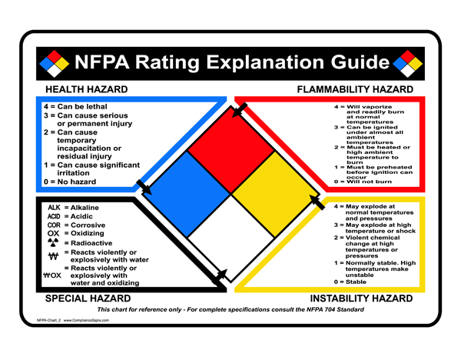
Globally Harmonized System vs NFPA

Slide 11
Chemicals Used at Carrington Power Station
Concentrated Sulphuric Acid H₂SO4 96%
Soda Caustic NaOH 25-50%
Ferric Chloride 40% FeCl₃
Sodium Hypochlorite 15% NaOCl
Flocculant polymer
Concentrated Ammonia 30% NH₃
Tri-Sodium Phosphate Na₃PO4
Sodium Bi Sulphite
Anti-Scalant
Citric Acid
Active Carbon
Various Reagents for WSC online monitoring
pH Reducer (Sodium Hydrogen Sulphate)
pH increaser (Sodium Bi Carbonate)
Chlorine Dioxide
Calcium Hypochlorite
Foam Doctor
H₂/CO₂/N₂
Various Construction Chemicals (glues, thinners, etc.)

Slide 12
Never Mix Chemicals !!!
Acid with Base - (Exothermic)!!!
Reducing Agent with Oxidizing Agent (Exothermic)!!!
Concentrated Sulphuric acid with water (Exothermic)!!!
Concentrated NaOH with water (Exothermic)!!!
Any two chemicals without understanding the chemistry – could release heat or gas

Slide 13
Incompatible
Sulphuric acid with rubber/latex
Ferric chloride with Stainless Steel
Carbon steel with very high pH (Caustic corrosion)
Carbon steel with very low pH (acid corrosion releases H₂ gas)
Concrete with acid (releases CO₂)
Concentrated ammonia with hot works
NaOCl with Acid
Acid with Base

Slide 14
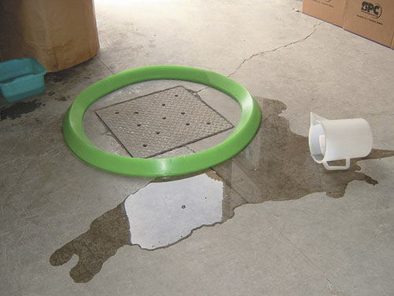
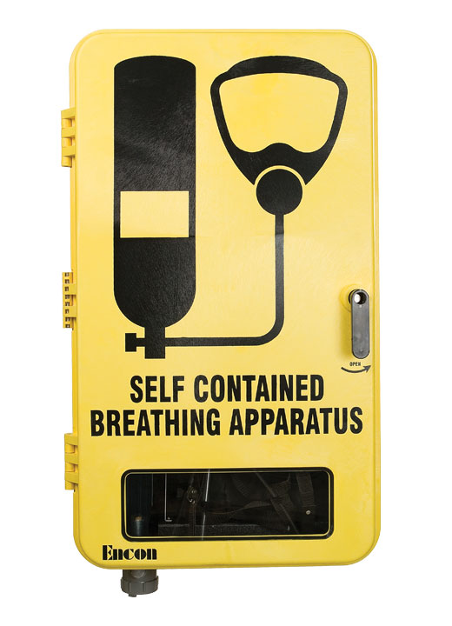
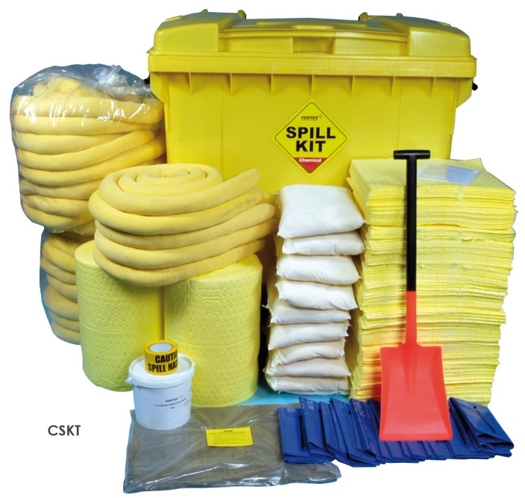
PPE/Small Spill Containment/Kit

Slide 15
Large Spill

Slide 16
Bulk Chemical Unloading

Slide 17
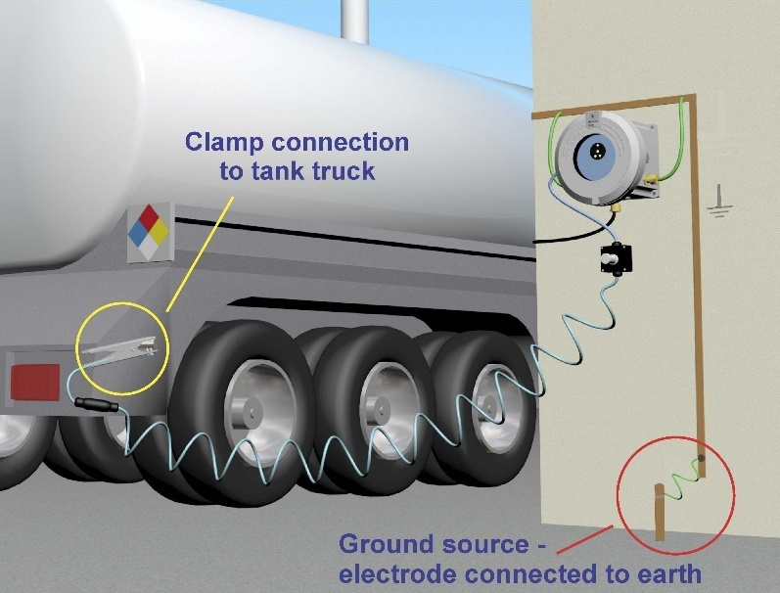
Safety In Engineering
Earth
Dry Lock Connection
Layers of Protection Analysis in Design Phase:
1. Overflow prevention 2. Recommended Maintenance and Inspection Routine
Crash Barrier
Wheel Chocks

Slide 18
Emergency Response
In case of exposure, flush with plenty of water and remove contaminated clothing
To neutralize spills:
Neutralize acid with mild base (Na₂CO₃)
Neutralize Base with mild acid (Sodium Bi Sulphate)
Organics with Active Carbon
Dilution is NOT the solution to Pollution (from pH 13 to pH 7 need x1000,000 dilution)
Prevent leakage into waterways
In case of large spill consult MAPP (Major Accident Prevention Plan)

Slide 19
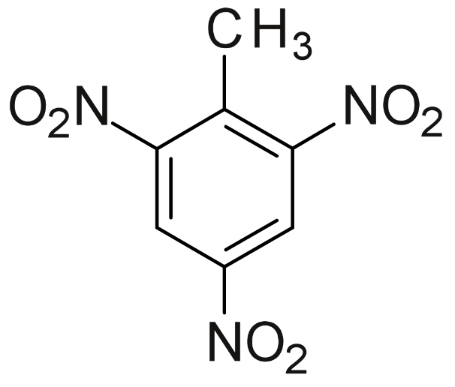
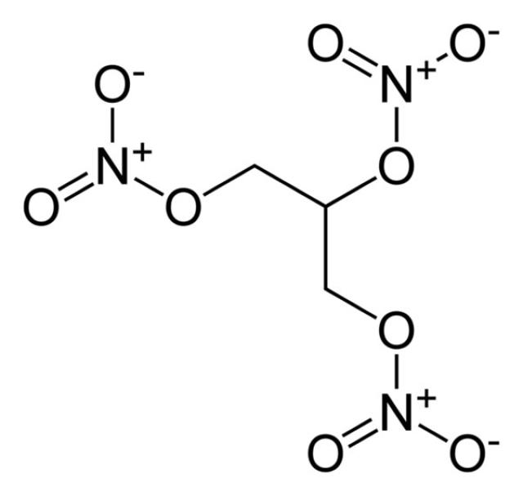
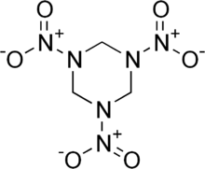
Questions? Remarks?
Thank you for your attention.
Be Safe !!!!

